Slide 1
Den nye upersonlige/passive konstruktion i islandsk: Oprindelse og udbredelse The New Impersonal/Passive in Icelandic: Origin and Diffusion
Höskuldur Þráinsson
University of Iceland
hoski@hi.is
https://uni.hi.is/hoski/

Slide 2
Outline of the talk
Introduction
What is the “The New (Impersonal) Passive” like?
Why – and to whom – is it interesting?
Some ideas about the origin (and nature) of the NIP
foreign influence
a reanalysis of impersonal active/passive constructions
Review of previous research on the NIP (mainly diffusion)
Sigríður Sigurjónsdóttir and Joan Maling
Finnur Friðriksson
IceDiaSyn
Predictions for the future – and development in real time
Anton Karl Ingason, Legate and Yang
RAUN
Concluding remarks

Slide 3
What is “The New (Impersonal) Passive” (NIP) like?
The Canonical Passive (CanP) in Icelandic:
a. Löggan handtók stúdentana.
the-cop(N.sg.) arrested(sg.) the-students(A.m.pl.)
b. Stúdentarnir voru handteknir (af löggunni) (CanP A)
the-students(N.m.pl.) were(pl.) arrested(m.pl.) (by the cop)
Standard (relatively informal) description of the formation of CanP A:
1. patient undergoes “movement” to subject position
2. case conversion: Acc-to-Nom, and (hence)
3. Nom. subject triggers agreement of finite aux. and participle
a. Löggan sleppti stúdentunum.
the-cops(N.sg.) released(sg.) the-students(D.m.pl.)
b. Stúdentunum var sleppt (af löggunnni) (CanP B)
the-students(D.m.pl.) was(sg.) released(n.sg.) (by the cop)
Standard (relatively informal) description of CanP B:
1. patient undergoes movement to subject position
2. no case conversion (Dat (and Gen) preserved) and (hence)
3. no agreement

Slide 4
What is the NIP like, 2?
The Expletive Canonical Passive A (ExplCanP A):
(1) a. Það voru einhverjir stúdentar handteknir. (ExplCanP A1)
there were(pl.) some students(N.m.pl.) arrested(m.pl.)
b. Það voru handteknir einhverjir stúdentar. (ExplCanP A2)
there were(pl.) arrested(m.pl.) some students(N.m.pl.)
c. *Það voru stúdentarnir handteknir. (cf. a)
there were(pl.) the-students(N.m.pl.def.) arrested(m.pl.)
d. ?*Það voru handteknir stúdentarnir. (cf. b)
there were(pl.) arrested(m.pl.) the-students(N.m.pl.def.)
Standard (relatively informal) description of ExplCanP A:
1. patient can undergo “short movement” (cf. a) but does not have to (cf. b).
2. case conversion Acc-to-Nom and (hence)
3. agreement of the finite aux. and the participle (as in CanP A)
4. Definiteness Effect (cf. c and d, typical of expletive constructions)

Slide 5
A digression on Danish
A similarity between Icelandic and Danish:
Expletive constructions show the Definiteness Effect:
a. Der er en mus/*musen/*den i badekarret.
b. Der blev arresteret en student/*studenten/*han/*ham.
Some differences between Icelandic and Danish:
There is no agreement in Danish passives:
(ii) Studenten/Studenterne blev arresteret.
Danish (like Norwegian, Swedish, English) typically only has one subject position in expletive constructions whereas Icelandic has two (cf. (1a,b) on the preceding slide):
(iii) a. Der blev arresteret en student.
b. *Der blev en student arresteret.
(For more on expletive constructions in Icelandic and Scandinavian see e.g. Höskuldur Thráinsson 2007, chapter 6, with references.)

Slide 6
What is the NIP like, 3?
The Expletive Canonical Passive B (ExplCanP B):
a. Það var einhverjum stúdentum sleppt. (ExplCanP B1)
there was(sg.) some students(D.m.pl.) released(n.sg.)
b. Það var sleppt einhverjum stúdentum. (ExplCanP B2)
there was(sg.) released(n.sg.) some students(D.m.pl.)
c. *Það var stúdentunum sleppt. (cf. a)
there was(sg.) the-students(D.m.pl.def.) released(n.sg.)
d. ?*Það var sleppt stúdentunum. (cf. b)
there was(sg.) released(n.sg.) the-students(N.m.pl.def.)
Standard (relatively informal) description of ExplCanP B:
1. patient can undergo short movement (cf. a) but does not have to (cf. b).
2. no case conversion and (hence)
3. no agreement
4. Definiteness Effect (cf. c and d)

Slide 7
What is the NIP like, 4?
The NIP corresponding to ExplCanP A:
(1) a. Það var handtekið einhverja stúdenta. (NIP A)
there was(sg.) arrested(n.sg.) some students(A.m.pl.)
b. Það var (sg.) handtekið stúdentana. (NIP A)
there was(sg.) arrested(n.sg.) the-students(A.m.pl.def.)
c. *Það var stúdentana handtekið.
there was(sg.) the-students(A.m.pl.def.) arrested(n.sg.)
Standard (relatively informal) description of NIP A (red = different from ExplCanP A):
1. no case conversion (Acc-to-Nom) and (hence)
2. no agreement of the finite aux. nor the participle
3. also no Definiteness Effect (cf. b)
4. patient cannot undergo (short) movement (cf. c), i.e. not occur in the “higher” subject position.
Ergo: NIP A seems very different from Expletive Cananonical Passive A

Slide 8
What is the NIP like, 5?
The NIP corresponding to ExplCanP B (green = OK, red = not OK):
(1) a. Það var sleppt einhverjum stúdentum. (√NIP/√ExplCanP B)
there was(sg.) released(n.sg.) some students(D.m.pl.)
b. Það var sleppt stúdentunum. (√NIP/ ?*ExplCanP B)
there was(sg.) released(n.sg.) the-students(N.m.pl.def.)
c. *Það var stúdentunum sleppt. ( *NIP/ *ExplCanP B) there was(sg.) the-students(D.m.pl.def.) released(n.sg.)
Standard (rather informal) description of NIP B (blue = different from ExplP)
1. patient cannot undergo short movement (cf. c).
2. no case conversion and (hence)
3. no agreement
4. no Definiteness Effect (cf. b)
Note that example a is ambiguous and example b can (for most speakers at least) only be the NIP (cf. below).

Slide 9
What is the NIP like, 6?
Like any other “expletive construction” in Icelandic, the NIP need not begin with the expletive element það. If some element is fronted, the expletive does not show up (this is different from Danish expletive der/det):
(1) a. Það var dansað alla nóttina. (impers. pass.)
there was danced all the-night
b. Alla nóttina var (*það) dansað.
a. Það var barið mig í gær. (NIP)
there was hit me(A) yesterday
b. Í gær var (*það) barið mig.

Slide 10
Why is it interesting to study the NIP?
It appears to be a spontaneous structural change in the syntax (reanalysis or reinterpretation of existing structures) — no obvious source in other languages. Hence it may shed light on the nature of such changes.
It is apparently quite new (first noticed in late 20th century) and (probably) still “in progress”. It will be interesting for linguists of different persuasions to follow its development. Of particular interest to many is how structural and social forces will interact (cf. below).

Slide 11
The Origin (and Nature) of the NIP
Foreign influence?
Maling and Sigríður Sigurjónsdóttir (2002, 2012, etc.) argue that the NIP is an active rather than a passive construction and thus more like the Polish -no/to construction, cf. their table (2012:255):
S&J argue that the NIP is more similar to the active Polish -no/to construction than to its Ukrainian passive counterpart. Poles are the largest national minority in Iceland. So could Polish in Iceland be the source for the NIP? What would historical linguists say if they discovered this in 2115?

Slide 12
The Origin ..., 2
Triggered by the existence of impersonal or expletive active constructions where there appears to be no Definiteness Effect:
The Observational Expletive (cf. Sigríður Sigurjónsdóttir & Joan Maling (Sigga and Joan, S&J) 2001:129n, 131n; Halldór Ármann Sigurðsson 1989:294ff.):
a. Bjórinn er búinn.
the-beer(N.m.sg.def.) is finished(m.sg.)
b. Það er búinn bjórinn.
there is finished(m.sg.) the-beer(N.m.sg.def.)
a. Tærnar á henni eru svo litlar.
the-toes(N.pl.f.def.) on her are(pl.) so small(f.pl.)
‘Her toes are so small.’
b. Það eru svo litlar á henni tærnar.
there are(pl.) so small(f.pl.) on her the-toes(N.pl.f.def.)

Slide 13
The Origin..., 3
The Eventive (explanatory) Expletive (cf. Eiríkur Rögnvaldsson 1984:365, Halldór 1989:294ff.):
A Hvað kom fyrir?
what came for
‘What happened?’
B a. Bíllinn bilaði.
the-car(N.def.) broke-down
b. Það bilaði bíllinn.
there broke-down the-car(N.def.)
‘Það bilaði bíllinn.’

Slide 14
The Origin..., 4
Triggered by the existence of impersonal or expletive active constructions where the (indef.) argument (i.e. the subject) can be Acc (so there is no agreement):
Psych-verb and fate-verb constructions (cf. Halldór 2011:166)
a. Það langaði marga íbúa heim.
there longed(sg.) many residents(A.m.pl.) home
‘Many (of the) residents wanted to go home.’
b. Það rak marga íbúa að landi.
there drove(sg.) many residents(A.m.pl.) to land
‘Many (of the) residents drifted ashore.’
(cf. also the quite common variant:
(2) %Margir íbúar ráku að landi.
many residents(N.pl.) drifted(pl.) ashore)

Slide 15
The Origin..., 5
Triggered by the existence of Impersonal/Expletive Passive constructions with intransitive verbs:
The Impersonal Passive (cf. Sigga and Joan, Joan and Sigga Halldór & Egerland 2009:166ff., Halldór 2011:148ff.):
a. Það var dansað alla nóttina.
there was danced all night(A)
‘People danced all night/There was dancing all night.’
Cf. also Danish: Der blev danset hele natten.
b. Það var talað við strákana í gær.
there was(sg.) talked to the-boys(A.m.pl.def.) yesterday
‘People talked to the boys yesterday.’
Cf. also Danish: Der blev snakket med ...
c. Það var talað um að fara
there was talked about to go
‘People talked about going.’
Cf. also Danish: Der blev snakket om at ...

Slide 16
The Origin..., 6
Ambiguous Expletive Passives (cf. Thórhallur Eythórsson 2008:211-212, cf. also Anton Karl Ingason, Legate and Yang 2012):
a. Það var skammað eitthvert barn. ExplCanP A / NIP
there was(sg.) scolded(n.sg.) little child( N./A. n.sg.)
‘A little child was scolded.’
b. Það var hrint einhverjum strák. ExplCanP B / NIP
there was(sg.) pushed(n.sg.) little boy(D.m.sg.indef.)
‘A little boy was pushed.’
Note:
There is never any distinction between Nom and Acc in neuter nouns (cf. the a-example) and no difference between “lack of agreement” and “agreement with a neuter singular noun”.

Slide 17
The Origin..., 7
Preliminary conclusion :
Icelandic has a number of “impersonal” (or expletive) constructions, active and passive, that may very well have served as structural sources for the NIP. Some of them are even ambigous in a relevant sense.
But the actuation problem remains: Why did the NIP not really emerge clearly until late in the 20th century (cf. below)?
Possible solutions to the actuation problem:
Increased frequency of relevant impersonal constructions serving as sources for the reanalysis (some of them ambiguous) or some other difference in the input?
Sociolinguistic explanations?

Slide 18
Earliest mentions of the NIP
It was noted in prescriptive columns in Icelandic newspapers around 1980:
Gísli Jónsson in a newspaper column on language preservation 1979: Calls the following example “impoverished child language”:
Það var barið mig í bakið.
there was hit(n.sg.) me(A m./f.) in the-back
Helgi Hálfdanarson 1982 in a newsp. column on lg. preservation:
(2) Það var sagt honum að fara.
there was told(n.sg.) him(D.m.sg.) to go

Slide 19
Earliest mentions, 2
It was noted by scholars around the same time:
Helgi Bernódusson (1982) in an MA-thesis on impersonal verbs:
(1) a. Það var hjálpað mér í skólanum.
there was helped(n.sg.) me(D m./f.sg.) in the-school
b. Það var skilið mig eftir.
there was left(n.sg.) me(A m./f. sg) behind
Jón G. Friðjónsson (1989), monograph on verbal constructions:
a. ?Það var fleygt bókunum.
there was thrown-out(n.sg.) the-books(D f.pl. def.)
b. ?Það var saknað stráksins.
there was missed(n.sg.) the-boy(G m.sg. def.)

Slide 20
Earliest mentions, 3
Noted by scholars, late 20th century, contd.
Halldór Ármann Sigurðsson (1989) in his dissertation:
Það var kosið hana í gær.
there was elected(n.sg.) her(A f.sg.) yesterday
Helgi Skúli Kjartansson (1991, paper in a periodical published by teachers of Icelandic). He coined the term “The New Passive”:
a. Það var platað mig.
there was tricked(n.sg.) me(A m./f. sg.)
b. Það var hrint mér.
there was pushed(n.sg.) me(A m./f. sg.)
c. Það var saknað mín.
there was missed(n.sg.) me(A m./f. sg.)

Slide 21
Earliest attested examples of the NIP
Sigríður Sigurjónsdóttir and Joan Maling (2001:146) give (1a,b) as the earliest examples they know of:
a. Það var bólusett okkur. (Nothern Icel. 1959)
there was vaccinated(n.sg.) us (A. pl.)
b. Það var gefið mér nammi. (Western Icel. 1968)
there was given(n.sg.) me(D.m./f. sg.) candy
Sporadic examples can be found from at least the beginning of the 20th century (cf. Einar F. Sigurðsson 2012):
(2) a. Hér var tekið þátt í minningarathöfninni. (1925)
here was taken(n.sg.) part(A.m.sg.) in the-memorial service
b. Það var gert grein fyrir þessu.
there was done(n.sg.) account(A.f.sg.) for this
‘This was accounted for.’
(many examples in newspapers from 1920s onward)

Slide 22
Sigríður Sigurjónsdóttir and Joan Maling
The first extensive survey was done by Sigríður Sigurjónsdóttir and Joan Maling (S&J) 1999–2000 (cf. Sigga and Joan 2001, Joan and Sigga 2002, Sigríður S. 2015):
Method and subjects:
Judgment task
Written questionnaire, two possibilities (cf. next slide)
Almost 1700 teenagers (15 year olds) from different parts of the country.
200 adult controls (mostly 40–80 years old).

Slide 23
S&J, 2
An illustration of the tasks in S&J’s study:
Instructions: Put an X in the appropriate column:
Yes = This is something one can say!
No = This is something one cannot say!

Slide 24
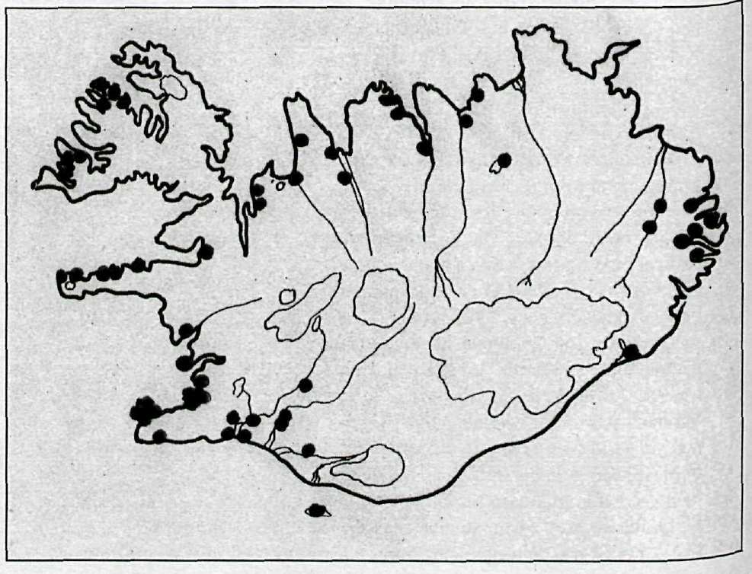
S&J, 3
Places visited by S&J’s team (cf. S&J 2001:180):

Slide 25
S&J, 4
Some reasons to think that S&J’s methodology worked reasonably well:
their fillers included “obviously grammatical” and “obviously ungrammatical” examples and they weeded out those (actually very few) subjects that gave incoherent answers to examples of this sort
their results were systematic
their results have to large extent been replicated by later studies using similar methodology — but also to some extent different methodology (cf. below)

Slide 26
S&J, 5
The most striking result obtained by S&J:
Up to 70% of the NIP examples were accepted by the teenagers (depending somewhat on sentence type and with some geographical variation, cf. below)
Almost all the adults rejected it (typically only 4–5% of the examples were accepted in each location, cf. below).
S&J’s interpretation:
We have here an instance of “linguistic change in apparent time”, i.e. A linguistic change in progress. Also assumed by Anton Karl Ingason, Legate and Yang 2012 and by Höskuldur Þráinsson et al. 2013.
An important question:
Could this be an instance of “age grading”?

Slide 27
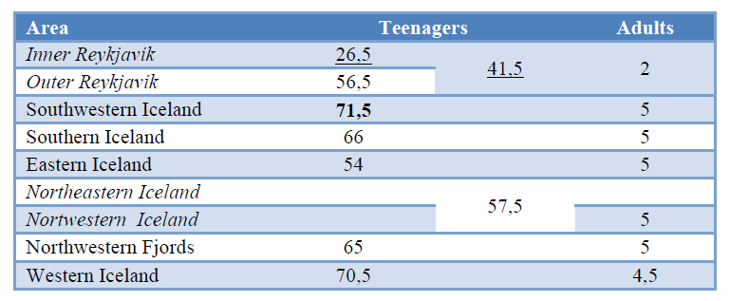
S&J, 6
S&J on the geographical distribution:
Acceptance (% of the examples) of the NIP (adapted from Sigríður Sigurjónsdóttir 2015): (Inner) Reykjavík stands out:

Slide 28
S&J, 7
S&J on correlation with parents’ education:
Acceptance of NIP examples (% accepted) and mother‘s education (adapted from S&J 2001:142–143, averages for the whole country; high school ≈ ‘gymnasium’ in Danish):
Elementary High University
% accepted: 59.9 55.1 46.3
p = 0.000 (ANOVA F_{(2, 1541)} = 12.997 )
For father’s education the figures are
p = 0.001 (ANOVA F_{(2, 1545)} = 6.775 )
Not entirely clear from S&J 2001 to what extent this accounts for the differences within Reykjavík: Mother’s education alone does not tell the whole story.

Slide 29
S&J, 8
S&J on gender differences:
No difference between boys and girls on the average (average acceptance 60.2% for boys, 60.3% for girls)

Slide 30
Finnur Friðriksson
Finnur Friðriksson’s research around 2000 (the basis for his dissertation work, cf. Finnur F. (FF) 2008, 2011).
Method and subjects:
A total of 108 subjects from 9 locations (cf. below), divided into three age groups: 16–20, 21–65, 66+ (4 from each in each location)
Recordings of spontaneous speech (44 sessions, approx. 30 hours in all – this was the main source)
Written material from 52 of the participants
Some interviews afte the recordings were made.

Slide 31
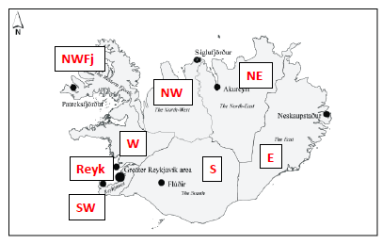
Finnur Friðriksson, 2
The locations visited by Finnur (cf. FF 2011:29):
The lines and labels show a common division into 8 areas.

Slide 32
Finnur Friðriksson, 3
Occurrence of the NIP in FF’s material:
Written material:
908 passives in all, only 0.4% of these are the NIP (4 expls.)
Spontaneous speech material:
494 passives in all, 2.6% of these are the NIP (13 examples)
Distribution of the spoken NIP examples by age groups:
percentages | 16–20 | 21–65 | 66+ | total
% NIP out of all passive examples | 6.3 | 2.9 | 0 | 2.6% (13 out of 494)
% of speakers producing some NIP | 26.7 | 10 | 0

Slide 33
Finnur Friðriksson, 4
FFʼs cnclusion on the NIP:
The NIP hadn’t really gained any foothold in the (stable) Icelandic language community at the beginning of the 21st century.
Question:
Does this mean that the acceptance of the NIP by the teenagers in the S&J study was an indication of age grading (i.e. adolescent language) and not of linguistic change in apparent time?

Slide 34
IceDiaSyn
IceDiaSyn (Icelandic Dialect Syntax) 2005–2008
(part of the network ScanDiaSyn):
Method and subjects:
Main method: Written questionnaires: mostly judgments ... but also forced choice between alternatives, fill-ins.
Structured interviews with some of the subjects a few months later.
Comparison with corpora in some instances (cf. Ásta Svavarsdóttir 2013).
3x720+ subjects, four age groups (15, 20–25, 40–45, 65–70), aiming for 8 from each group, approx. 25 locations each time. NIP included in the first survey (N = 772).

Slide 35
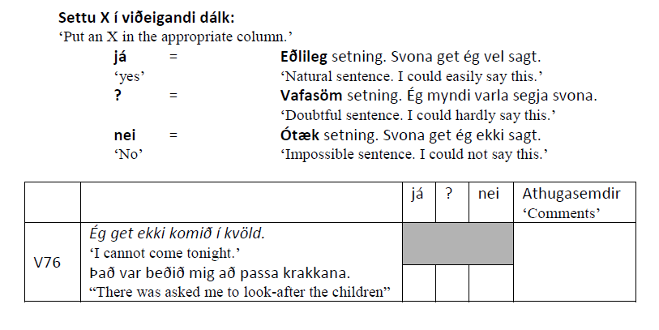
IceDiaSyn, 2
Typical format of the written questionnaire:
Changes from the S&J format: Context sentences.
Three alternatives. Short passage read explaining purpose.

Slide 36
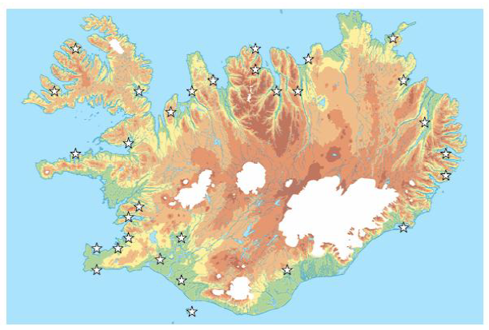
IceDiaSyn, 3
Locations visited in IceDiaSyn:

Slide 37
IceDiaSyn, 4
Generational differences in the acceptance of NIP (average for all the examples tested):
15 20–15 40–45 65–70
IceDiaSyn. 48.3 19.9 5.7 5.8
Very clear generational differences again (youngest and the two oldest age groups correspond to the age groups in S&J‘s study):
The acceptance figures for the youngest generation are somewhat lower than those obtained by S&J, but note that the figures are not exactly comparable:
The subjects in IceDiaSyn had three choices (yes, doubtful, no), those in S&J’s study had two (yes, no). More on this below.

Slide 38
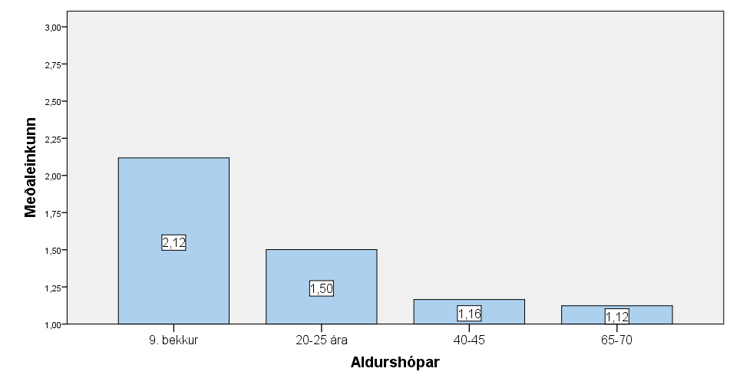
IceDiaSyn, 5
Generational differences, 2: “mean grade”
Mean: 3 = accept all examples, 1 = reject all examples.
p = 0.000 (r = 0.614, F_{(3,738)} = 187.072)

Slide 39
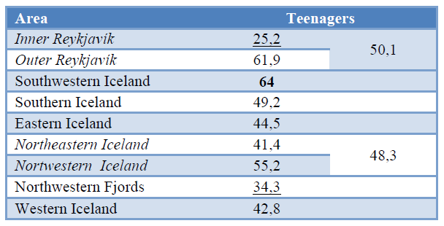
IceDiaSyn,6
Geographical distribution of NIP (teenagers only):
Inner Reykjavík still lowest acceptance rate in % ...

Slide 40
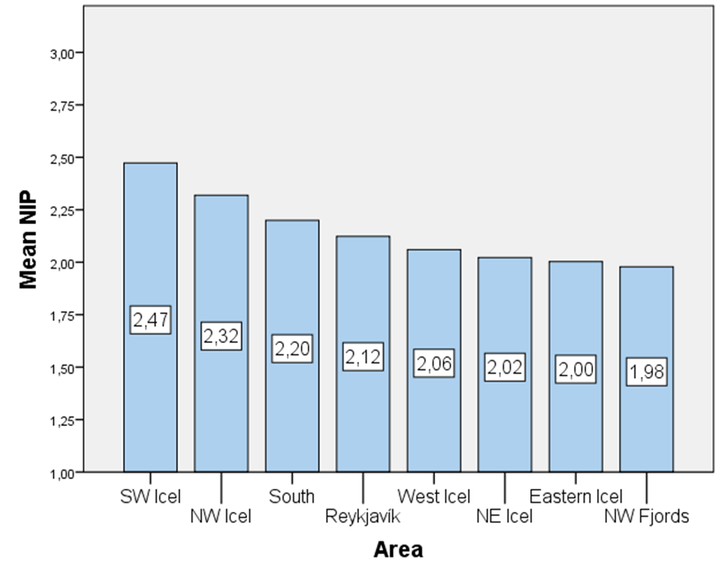
IceDiaSyn,7
Geographical distribution, teenagers only, 2:
Mean grade (3 = accept all, 1 = reject all)
Significant difference (p = 0.001, F_{(7, 734)} = 3.542)

Slide 41
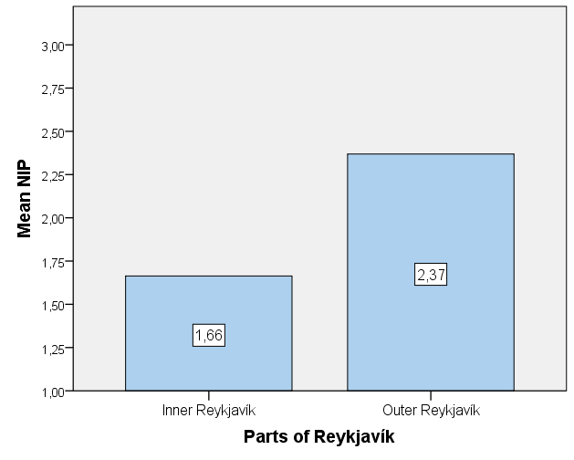
IceDiaSyn, 8
Acceptance of the NIP by teens in Inner and Outer Rvk:
Significant difference: r = 0.500, p = 0.013 (N 32)

Slide 42
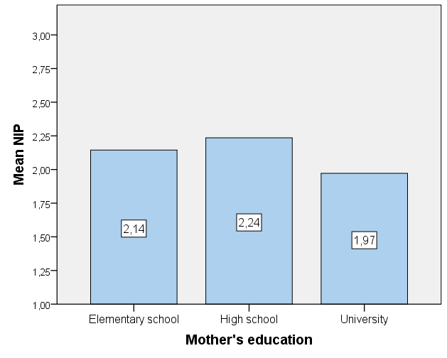
IceDiaSyn, 9
Correlation with mother’s education (teenagers only):
Weakly significant: p = 0.034 (F_{(2, 185)} = 3.441)
(Not within Reykjavík: p = 0.107 (F_{(2, 19)} = 2.524 ); too few subj.)

Slide 43
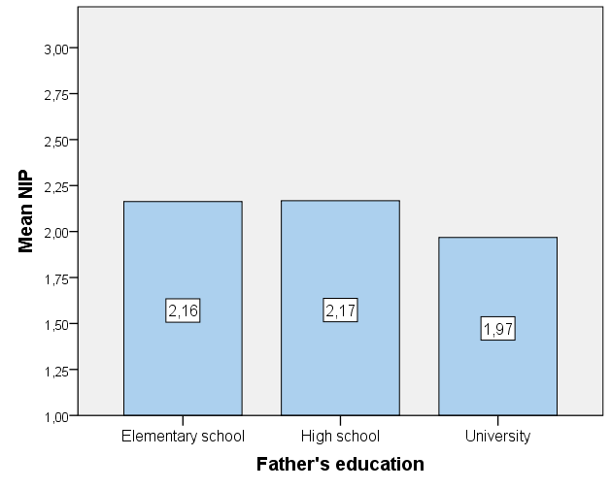
IceDiaSyn, 10
Correlation with father’s education (teenagers only):
Not significant: p = 0.144 (F_{(2, 178)} = 1.957)

Slide 44
IceDiaSyn, 11
Educational levels within Reykjavík:
There is no significant difference in the education level of adult subjects from Inner Reykjavík and elsewhere in the Reykjavík area or in outer regions of Reykjavík proper.
If you just look at the education level of the mothers of the young participants (the teenagers) in Reykjavík proper, the education level of the mothers in Inner Reykjavík is significantly higher (r = – 0.552, p = 0.008, N = 22). There is less difference in the educational level of the fathers (r = – 0.382, p = 0.087, N = 21).

Slide 45
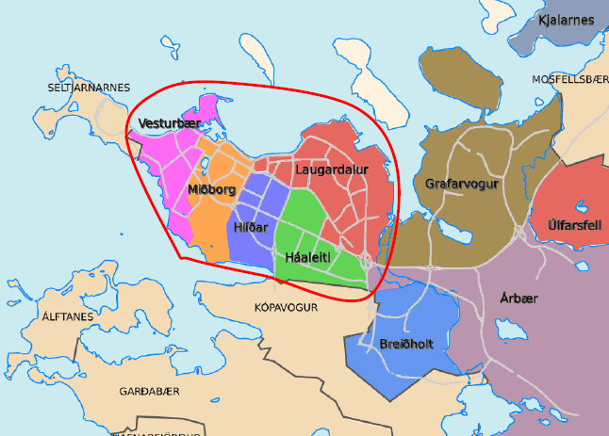
IceDiaSyn, 12
Inner and Outer Reykjavík:
The encircled area is the older part of town, Inner Rvk.

Slide 46
IceDiaSyn, 13
More on education and acceptance of the NIP:
There is a significant correlation between educational level of adult subjects (age groups 2, 3 and 4) and their acceptance of the NIP examples: Higher educational level, less likely to accept the NIP
Pearsons correlation (partial, controlling for age among the adults): r = – 0.286, p = 0.000;
ANOVA F_{(2, 246)} = 11.815, p = 0.000

Slide 47
S&J, FF and IceDiaSyn
Interim summary:
All studies found clear generational differences.
FF found very few examples of the NIP in his spontaneous speech material and the examples of writings he collected.
S&J and IceDiaSyn found significant differences between Inner and Outer Reykjavík w.r.t. acceptance of the NIP by teens.
IceDiaSyn found clearer regional differences than S&J.
S&J found significant correlations between acceptance of the NIP and the educational level of the teenagers’ parents. In IceDiaSyn there was a weakly significant correlation with the mothers’ education on the national level (although not within Reykjavík (too few subjects knew about their mother’s educ.).
To the extent that adults accept the NIP at all, they are more likely to do so the lower their educational level.

Slide 48
Anton Karl Ingason, Legate and Yang
Anton, Legate and Yang (2012, henceforth ALY):
Their premisses:
The NIP is spreading rapidly (cf. the generational differences found by all researchers, indicative of “linguistic change in apparent time”)
The NIP is spreading “at the expense of the functionally equivalent CP”
Their prediction:
The NIP will spread as predicted by a steep S-curve and will have ousted the CP by 2050. They employ a mathematical model designed by Yang (cf. e.g. Yang 2002).

Slide 49
ALY, 2
Anton, Legate and Yang (ALY) further suggest (2012:93) that (my emphasis):
“there is a reason to believe that the [NIP] change is a particularly good candidate for a type of variation that is not sensitive to social evaluation”
Base this on Labov and Harris (1986:21):
Abstract linguistic structure has little or no social impact on members of the community. The interface of language and society is narrow, and primarily on the surface: the words and sounds of the language.
Cf. also Anton Karl, Einar Freyr and Joel Wallenberg 2012 on the OV to VO change in the history of Icelandic.

Slide 50
ALY, 3
But is the NIP likely to be insensitive to social pressure?
It was soon noticed (and maybe first and is often commented on) by “language preservers” (cf. above).
According to Finnur Friðriksson (2011:43), his subjects were more negative in interviews towards the NIP than other innovations he studied (Dative Sickness, Extended Progressive ...).
The NIP is fought against in schools (although the teachers cannot really explain what it is).

Slide 51
IceDiaSyn and S&J
But how rapidly is the NIP really spreading?
We can compare the results IceDiaSyn to those of S&J more carefully.
IceDiaSyn was partially a “trend study” building on S&J‘s findings for the NIP since IceDiaSyn included comparable age groups:
teenagers again (15 year olds, as in S&J‘s study)
adults (over 40 as in S&J‘s study)
subjects from the same generation (now some 6 years older, included in the 20–25 year group)

Slide 52
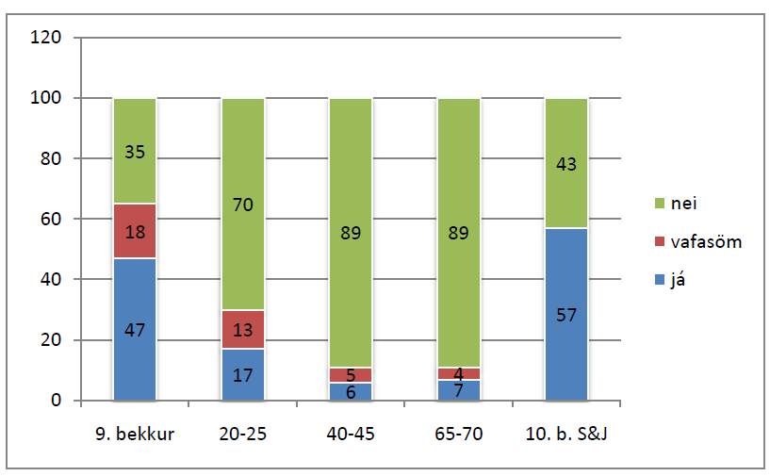
IceDiaSyn and S&J, 2
Detailed comparison of IceDiaSyn and S&J:
Columns 1–4 = different age groups in IceDiaSyn
Column 5 = the teenagers in the study by S&J
green (top of column) = % of negative judgments
blue (bottom of column) = % of positive judgments
red (middle of column) = % of “questionable”

Slide 53
IceDiaSyn and S&J, 3
Comments on the comparison:
The acceptance rate of the teenagers is roughly the same in the two studies (more on this below):
IceDiaSyn: 47% positive judgments + 18% questionable judgments
S&J: 57% postitive judgments (their study only had ‘yes’ and ‘no’)
The NIP has not spread to the two oldest generations.
But: The acceptance rate by the second youngest age group in IceDiaSyn is much lower than expected (only 17% positive, 13% questionable) since this is (partially) the same generation as the one S&J tested (where we had 57% positive judgments of the NIP examples) .

Slide 54
IceDiaSyn and S&J, 4
Three possible explanations of the observed differences:
Teenagers are in general more likely than adults (and post-adolescents) to accept examples in studies like this. Their acceptance does not tell us much about their use.
What S&J found was evidence for age grading, not change in apparent time, so the NIP is not really spreading (cf. also FF‘s results)
The NIP is indeed spreading but much more slowly than ALY assumed (and predicted) because what S&J found was an “adolescent peak” (more on this below)

Slide 55
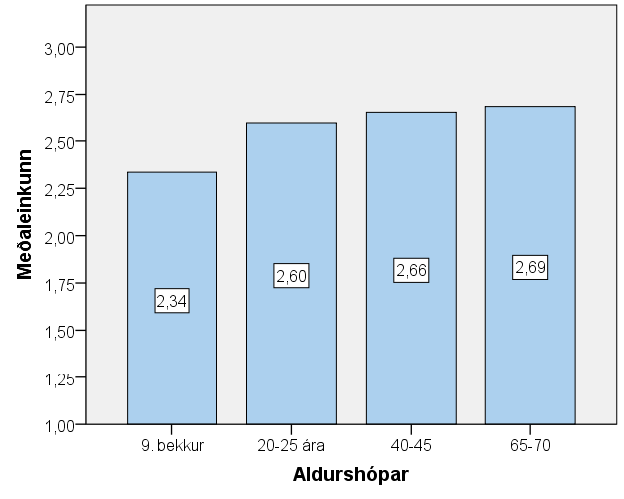
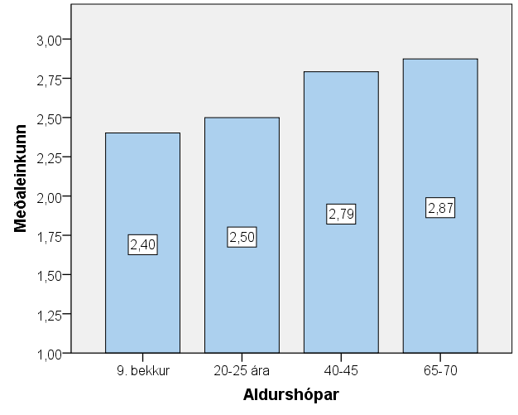
IceDiaSyn and S&J, 5
The teens were not generally more permissive in IceDiaSyn (cf. Höskuldur Þráinssonet al. 2013).
Indefinite alienable possession Agreement with Nom. Object
(e.g. hár mitt lit. “hair my”) (e.g. henni líkuðu gjafirnar
“her(D sg.) liked(pl.) the gifts(N pl.)”

Slide 56
IceDiaSyn and S&J, 6
Confirmation of the judgments in an interview task in IceDiaSyn:
Rewording task – instructions and model sentence:
Einhver hlýtur að vera heima.
someone must be at home
“Reword this by starting with Það ‘there’ or Það var ‘there was’ or Það voru ‘there were’ — and you can leave out the first word of the sentence.”

Slide 57
IceDiaSyn and SJ, 7
Rewording, contd.: Some of the examples
Nokkrar flugur voru í súpunni.
some flies were in the soup
→ Það voru nokkrar flugur í súpunni.
there were(pl.) some flies(N.pl.) in the soup
Fólkinu var bjargað úr eldsvoðanum.
the-people(D) were saved from the-fire
→ Það var(sg.) bjargað(n.sg.) fólkinu(D.pl.) úr eldsvoðanum.
there was saved the people from the fire
Honum var hrósað fyrir góða frammistöðu.
him(D) was praised for good performance
→ Það var hrósað(n.sg.) honum(D.sg.m.) fyrir góða frammistöðu.
there was praised him for good performance.
Those who had rejected the NIP could not reword (2) and (3).

Slide 58
RAUN
To find out whether the NIP is just “adolescent language” whether it is a “change in progress” we did a real time study: “Real time change in Icelandic phonology and syntax” (RAUN, 2010–2012):
Mostly a panel study reinterviewing /retesting subjects that participated in previous projects,
The syntactic part involved retesting 197 speakers who participated inS&J‘ original study and come from different parts of the country.
The retesting included 6 typical NIP examples tested in exactly the same way (except that context sentences were included this time). In the part reported on here, the subjects could only answer “yes” and “no” (not “?”) as in the original NIP study.

Slide 59
RAUN, 2
More on the questions asked in RAUN:
Is the NIP just “adolescent language”, meaning that what S&J and IceDiaSyn found was thus just evidence for age grading, as Finnur Friðriksson (2008, 2011) implied, and not change in apparent time?
Or can the difference between S&J and IceDiaSyn be interpreted as evidence for an “adolescent peak” (cf. e.g. Labov 2001:106, passim; Tagliamonte and D’Arcy 2009).
Does “Inner Reykjavík” still have a special status as the place where the NIP is least accepted?

Slide 60
RAUN, 3
Comparison of the judgments of 197 speakers 1999 & 2012:
Mean Scores (1 = accepts all, 3 = rejects all (note the reversal!)):
S&J 1999: 1.94
RAUN, same speakers 2010–2012: 2.58
Speakers who accept fewer NIP expls. 2012 than 1999: 71% (140)
Speakers who get the same “mean grade” 1999 and 2012: 23% (46)
Speakers who accept more NIP expls. 2012 than 1999: 6% (11)
Breaking down the numbers:
Speakers who reject all relevant NIP examples 2012 50% (99)
Speakers who reject all relevant NIP examples 1999 and 2012: 15% (30)
_ .. _ who reject all relevant NIP expls. 1999 but accept some 2012: 2.5% (5)
_ .. _ who reject all relevant NIP expls. 1999 but accept all 2012: 0% (0)
Accept all 1999 and 2012: 0.5% (1)
Accept all 1999 but reject some 2012: 10% (20)
Accept all 1999 but reject all 2012: 3% 6)

Slide 61
RAUN, 4
Most of the speakers accept fewer NIP examples 10 years later (when they are approx. 25 years old vs. 15 years old).
Still, relatively few of the “NIP-positive” have completely “outgrown the habit”: Only 35% (69) who accepted some NIP examples reject all of them now.
The results confirm the conclusion of IceDiaSyn that speakers typically do not acquire the NIP after the acquisition age (only 5 speakers who rejected all the examples in 1999 accept some now).
But how about age grading vs. adolescent peak?

Slide 62
RAUN, 5
Adolescent peak and the S-curve:
It has often been observed that linguistic innovations are “most popular” among adolscents (age range varies somewhat), i.e. more popular than among both younger speakers and older speakers (cf. e.g. Labov 2001:169ff. and passim, Tagliamonte and D’Arcy 2009, etc.). This is commonly referred to as the adolescent peak.
The so-called S-curve seems to be a commonly valid description of the diffusion of various kinds of innovations, including linguistic ones (cf. e.g. Kroch 2001:719ff., Blythe and Croft 2012).

Slide 63
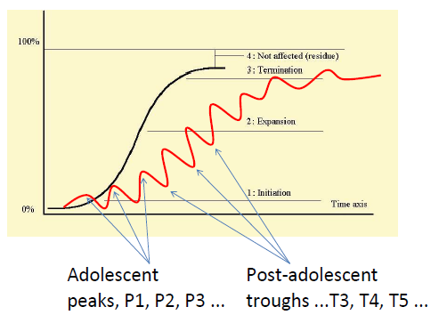
RAUN, 6
Post-adolescent troughs should smooth out the S-curve:

Slide 64
RAUN, 7
Important points expressed by the S-curve figure:
Even though T1 is lower than P1 and T2 is lower than P2, etc., P2 should be higher than P1, P3 should be higher than P2, etc. Similarly, T2 should be higher than T1, T3 should be higher than T2, etc. Otherwise there will be no diffusion in the linguistic community.
Important question:
Does this (i.e. P2 > P1 ..., T2 > T1 ...) hold for the diffusion of the NIP in the Icelandic speech communtity? If it does, then the NIP is gaining ground, if not, then the NIP is (still) an instance of “adolescent language” and what S&J and IceDiaSyn discovered is age grading and not change in apparent time.

Slide 65
RAUN, 8
Comparison of “mean scores ” in S&J 1999, IceDiaSyn 2006 & RAUN 2012 (where 1 = accepts everything, 3 = rejects everything and we are comparing scores for same or maximally similar examples):
Mean score for P1 (adolescents 1999): 1.94
Mean score for P2 (adolescents 2006): 1.90
Mean score for T1 (post-adolescents 2006): 2.47
Mean score for T2 (post-adolescents 2012): 2.50
Possible conclusions:
The NIP is (still) just “adolescent language”
We are (still) at the very bottom of the S-curve (since the NIP is a relatively recent innovation), hence very slow diffusion.

Slide 66
RAUN, 9
Some sociolinguistic points from RAUN:
Inner and Outer Reykjavík:
Mean grade for those who grew up in Inner Reykjavík: 2.67
Mean grade for those who grew up in Outer Reykjavík: 2.71
This difference is obviously not statistically significant (p = 0.75)
Correlation with education:
There is a medium strong and statistically significant correlation with education of the subjects now, i.e. the more educated speakers are less likely to accept the NIP now (r = 0.340, p< 0.001)

Slide 67
Concluding remarks
The distribution of the NIP suggests that it is “a real linguistic innovation” (or “real change”in the sense of Hale 2007 e.g.) in that it seems to be acquired during the acquisition period and does not spread freely across generations like typical changes in frequency of usage do (e.g. the Extended Progressive also studied in IceDiaSyn).
But there is a lot we do not really understand about its actuation and diffusion:
Why did the NIP suddenly gain ground in adolescent language towards the end of the last century (the actuation problem)?
Why is the NIP not spreading faster than it is — e.g. not as fast as ALY predict? What is the reason for the post-adolescent trough? Can negative attitude have this kind of effect on syntax?

Slide 68
References
Anton Karl Ingason, Einar Freyr Sigurðsson and Joel Wallenberg. 2012. Antisocial Syntax. Disentangling the Icelandic VO/OV Parameter and its Lexical Remains. Presented at DIGS 14, University of Lisbon, July 4–6.
Anton Karl Ingason, Julie Anne Legate and Charles Yang. 2012. The Evolutionary Trajectory of the Icelandic New Passive. U.Penn Working Papers in Linguistics 18(2):91–100.
Ásta Svavarsdóttir. 2013. Þágufallshneigð í sjón og raun. Notkun spurningakannana í samanburði við málnotkun. Höskuldur Þráinsson, Ásgrímur Angantýsson and Einar Freyr Sigurðsson (eds): Tilbrigði í íslenskri setningagerð I. Markmið, aðferðir og efniviður, pp. 83–110. Málvísinda-stofnun Háskóla Íslands, Reykjavík.
Blythe, Richard A., and William Croft. 2012. S-Curves and the Mechanisms of Language Change. Language 88(2):269–304.
Einar Freyr Sigurðsson. 2012. Germynd en samt þolmynd. Um nýju þolmyndina í íslensku. MA thesis, University of Iceland.
Eiríkur Rögnvaldsson. 1984. Rightward Displacement of NPs in Icelandic. In Kristian Ringgaard and Viggo Sørensen (eds.): The Nordic Languages and Modern Linguistics 5, pp. 361–368.
Finnur Friðriksson. 2008. Language Change vs. Stability in Conservative Language Communities: A Case Study of Icelandic. Doctoral dissertation, University of Gothenburg, Gothenburg.

Slide 69
References, 2
Finnur Friðriksson. 2011. Modern Icelandic – Stable or in a State of Flux? Scripta Islandica 62:19–50.
Gísli Jónsson. 1979. Íslenskt mál. Newspaper column in Morgunblaðið.
Hale, Mark. 2007. Historical Linguistics: Theory and Method. Blackwell, Oxford.
Halldór Ármann Sigurðsson. 1989. Verbal Syntax and Case in Icelandic in a Comparative GB Approach. Doctoral dissertation, University of Lund, Lund.
Halldór Ármann Sigurðsson. 2011. On the New Passive. Syntax 14(2):148–178.
Halldór Ármann Sigurðsson and Verner Egerland. 2009. Impersonal Null-Subjects in Icelandic and Elsewhere. Studia Linguistica 63(1):158–185.
Helgi Bernódusson. 1982. Ópersónulegar setningar. Cand.mag thesis, University of Iceland, Reykjavík.
Helgi Hálfdanarson. 1982. Gætum tungunnar. Newspaper column in Morgunblaðið.
Helgi Skúli Kjartansson. 1991. Nýstárleg þolmynd í barnamáli. Skíma 14:18–22.
Höskuldur Thráinsson. 2007. The Syntax of Icelandic. Cambridge University Press, Cambridge.

Slide 70
References, 3
Höskuldur Þráinsson, Ásta Svavarsdóttir, Eiríkur Rögnvaldsson, Jóhannes Gísli Jónsson, Sigríður Sigurjónsdóttir og Þórunn Blöndal. 2013. Hvert stefnir í íslenskri setningagerð? Um samtímalegar kannanir og málbreytingar. Íslenskt mál 35:57–127.
Jón G. Friðjónsson. 1989. Samsettar myndir sagna. Málvísindastofnun Háskóla Íslands, Reykjavík
Kroch, Anthony S. 1989. Reflexes of grammar in patterns of language change. Language Variation and Change 1:199–244.
Kroch, Anthony S. 2001. Syntactic Change. In Mark Baltin and Chris Collins (eds.): The Handbook of Contemporary Syntactic Theory, pp. 699–729.
Labov, William. 2001. Principles of Linguistic Change. Volume II: Social Factors. Blackwell, Oxford.
Labov, William, and Wendell A Harris. 1986. De Facto Segregation of Black and White Vernaculars. In David Sankoff (ed.): Diversity and Diachrony, pp. 1–24. Benjamins, Amsterdam.
Maling, Joan, and Sigríður Sigurjónsdóttir. 2002. The ‘New Impersonal’ Construction in Icelandic. Journal of Comparative Germanic Linguistics 5:97–142.

Slide 71
References, 4
Maling, Joan, and Sigríður Sigurjónsdóttir. 2012. Syntactic Change in Progress: The Icelandic „New Construction“ as an Active Impersonal. In Peter Ackema, Rhona Alcorn, Caroline Heycock, Danny Jaspers, Jeroen Van Craenenbroeck and Guido Vanden Wyngaerd: Comparative Germanic Syntax – The State of the Art, pp. 249–278. Benjamins, Amsterdam.
Sigríður Sigurjónsdóttir. 2015. Nýja þolmyndin nú og þá. Samanburður tveggja kannana. Ms. to appear in Höskuldur Thráinsson, Ásgrímur Angantýsson and Einar Freyr Sigurðsson (eds.): Tilbrigði í íslenskri setningagerð III, Málvísindastofnun Háskóla Íslands, Reykjavík.
Sigríður Sigurjónsdóttir and Joan Maling. 2001. Það var hrint mér á leiðinni í skólann – Þolmynd eða ekki þolmynd? Íslenskt mál 23:123–180.
Tagliamonte, Sali A., and Alexandra D‘Arcy. 2009. Peaks beyond Phonology. – Adolescence, Incrementation and Language Change. Language 85(1):58–108.
Thórhallur Eythórsson. 2008. The New Passive in Icelandic Really Is a Passive. In Thórhallur Eythórsson (ed.): Grammatical Change and Linguistic Theory – The Rosendal Papers, pp. 173–219. John Benjamins, Amsterdam.
Yang, Charles. 2002. Knowledge and Learning in Natural Language. Oxford University Press, Oxford.

