Slide 1
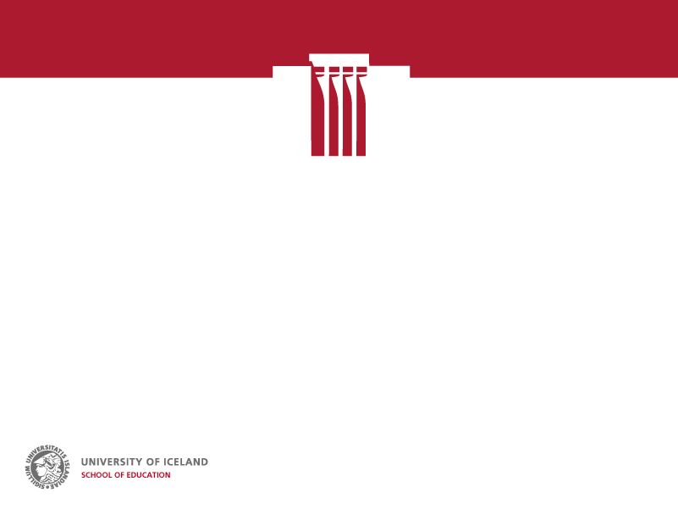
…What might be public about a public school education in 2030?
The third annual Twin Peaks Global Research Summit
Banff Springs Hotel,
Sunday, April 15,
9:00 – 4:00 pm
Are we circling the drain of global competencies or will we realize the meaning of the public in public education?
Jón Torfi Jónasson
Professor emeritus, Teacher Education, University of Iceland

Slide 2
Are we circling the drain of global competencies or will we realize the meaning of the public in public education? (These are two questions)
Are we circling the drain of global competencies?
Global or 21st century skills or competencies have been with us, now for at least four or five decades. The basic idea has in fact been with us for much longer, e.g. clearly raised by Locke, Rousseau and many, many others. This reflects the fact that we have known for a long time that in schools we are generally not doing the important things. But we cannot get to grips with what we want to replace them with. We also have powerful subjects and other institutions resisting change. The only thing many people know both within and outside education, is that it should be about something - else. A good example of this is the recent well-being rhetoric, and other OECD escapades.
There have been various attempts at specifying or defining all kinds of competencies or emphasis, but there are essentially three problems with all these endevours:
We don’t really know what to list (the least of the problems) and the various lists are varied and sometimes long (and quite different – which is not a problem)
We don’t know how to narrowly define any of the competencies, and thus not to assess them, neither in the short nor the long term (this problem is largely independent of whether we are for assessment)
We have no (little?) idea how to cultivate these, and we do not seriously address this in our ITE nor even in CPD (this like the other statements are general ones – there exist interesting exceptions)
Thus, the problem is not getting any worse, but it is staring us more clearly in the face and more people are gradually realising its essence and seriousness.

Slide 3
Are we circling the drain of global competencies or will we realize the meaning of the public in public education? (These are two questions)
will we realize the meaning of the public in public education?
This is the other part of the problem, and closely related to the first part. This is not getting any worse, but is starting to bother “us” more, as it is really starting to hurt education in schools.
This problem is essentially that we don’t know how to talk about education. We neither address what education is for, nor following on from that, what should be its ingredients, nor how it should be conducted. And we don’t know on which grounds we should base our discourse (science, philosophy, ...). And we, within the discipline of education, are largely to blame for this. We don’t talk in a language that is understood either among ourselves or the public and thus we cannot compete with the PISA type rhetoric.
(An example of the difficulty: At NERA – in Oslo in March – I took part in a panel discussion where the core question was: Is pedagogy a part of educational science or vice versa? To me pedagogy -education is, obviously, in many respects, different from educational science – but again … .)
In Iceland, the public discourse has changed in the last century and a half in Iceland, also with ambitious new curricula. But the popular discourse is in many ways strangely similar to what it was in a very different world when the system was being moulded and four years of schooling expected.
But now most young people go to school for 16-18 years (and many much longer), and each school year is much longer than it was a century ago and the world has changed dramatically and will continue to do so. The discourse is certainly not reflecting these changes.

Slide 4
Are we circling the drain of global competencies or will we realize the meaning of the public in public education? (These are two questions)
will we realize the meaning of the public in public education?
I note four reasons why the “public” in education needs to retain its traditional stature.
Education is meant to cultivate a community, at the local and the global level, - thus a public, dynamic community is an important goal
Education is a communal endeavour; its nature demands it takes place within a community of students and teachers; it is meant to cultivate a sense of community and learning to live with other people; it is a cultural endeavour not a technical one.
The complex essence of education repudiates its commodification, it needs to resist being transformed into commodifiable units or tasks (e.g. through tests, objectives, standardization in content and material). It is thus necessarily a public exercise. (But of course education is a commodity - we have the credential currency, perhaps the cre-coin (creditcoin) – similar to bitcoin).
In order to retain (or regain) its strength and dynamism education has to cultivate the engagement with and of its environment, - parents, industry, various voluntary and official bodies; it thus has to be a truly public endeavour.
Situating education within the public arena is a major factor in ensuring the equity within education which is perhaps its most important feature.
I think our main task is to discover and realize the meaning of education within education and there are several dimensions that should be attended to. One of the most important is issue is how do we genuinely involve the young people (students) in the process?

Slide 5
So we may ask what is the problem for education?
Is it a down-spiralling economy, neo-liberal ideology, commodification, testing regimes, standards, big or small data, competition or comparison, unfathomable futures, urbanization, multicultural settings, automatisation, new competencies, neuroplasticity, artificial intelligence, … ?
No, perhaps none of these represents the fundamental or underlying problem, even though all of these present challenges, that deserve and receive attention.
The main problem is that we shy away from deliberating and redefining education as our main focus and task. Many people accept that, yes, this is a difficulty, but then they don’t turn to address it but turn their attention to other pressing but more manageable issues to discuss.
And therefore (and I find it mind-boggling), in education we go right ahead to talk about standards, quality, good schools, excellent education, best practices, good teaching, etc., etc. – as if we had reached an agreement on what is the essence of education.

Slide 6
What is the problem for education - there are other takes, such as:
Traditionally, and obstinately, we continue to make serious and obvious mistakes, as I have partly implied already, by
introducing (important) skills or competencies that very few know what mean, and hardly anybody knows how to cultivate or measure (creativity, communication, critical thinking, entrepreneurship, virtues of various sorts, - an endless list …). The problem is that we need to do this, but we must acknowledge the difficulties. Also transferability (the transfer of training issue) and thus the importance of context, which are of paramount importance are often ignored.
preparing teachers in ITE to do things that are at best, not a priority for their students and communities – and not preparing them to understand and do things that might be a priority
not encouraging teachers to do what many of them know makes sense and is truly educational, - sensed by them even without an elaborated definition
The academia, the professional unions and governments, have to look critically at themselves and discuss what should be their role in addressing those issues. We? or they? are mostly not doing it.

Slide 7
Education is the essence of education. Thank you

