Slide 1

NERA 2020
Rethinking the futures of education in the Nordic countries
University of Turku
4.3-6.3.2020
NERA NW21b
Politics of Education and Education Policy Studies
10:45 - 12:15 Friday, 6th March, 2020,
Pub 5 Session VI
The extent, nature and impact of Nordic cooperation within the field of education from an Icelandic perspective.
March 6th 2020
Jón Torfi Jónasson
School of Education, University of Iceland
jtj@hi.is http://uni.hi.is/jtj/en/

Slide 2
Structure of the presentation
Introduction – an explanation
The questions – what are they?
Method for collecting data – difficulties
The potential solid indicators
The extent and multiplicity of professional cooperation
The nature of the cooperation in focus – what does it entail?
What is the impact – the outcome?
The direct, or documented or acknowledged visibility
Does the cooperation taking place – have anything to do with a Nordic model within the field of education?
Conclusions? Emerging questions and observations

Slide 3
Introduction – an explanation
According to the results of a project on Nordic policy interaction (POLTRAN) – there seems in the Icelandic case, not to be a very visible Nordic cooperation– using bibliometric evidence.
Personal experience – throughout “my” professional life; with UNESCO commissions, computers in education, various projects (e.g. connected to IIE in Stockholm), and various research connections for a long time. (I know a wide variety of examples to indicate the extent).
Thus, anecdotally I note the enormous interaction there seems to exist at many different levels, which is multifaceted, well-known, well connected and visible, but at the same time so segmented, isolated, scantily documented – and in a certain sense invisible or somehow hidden.
To me all these call for an exploration of the issue
There are several questions that beg answering. E.g. about the
The extent - how much is there?
The nature – a) at what levels (not only policy!?) – b) what does is it consist of ?
The impact – what is the impact or value of this cooperation; how should it be indicated, measured or discussed?

Slide 4
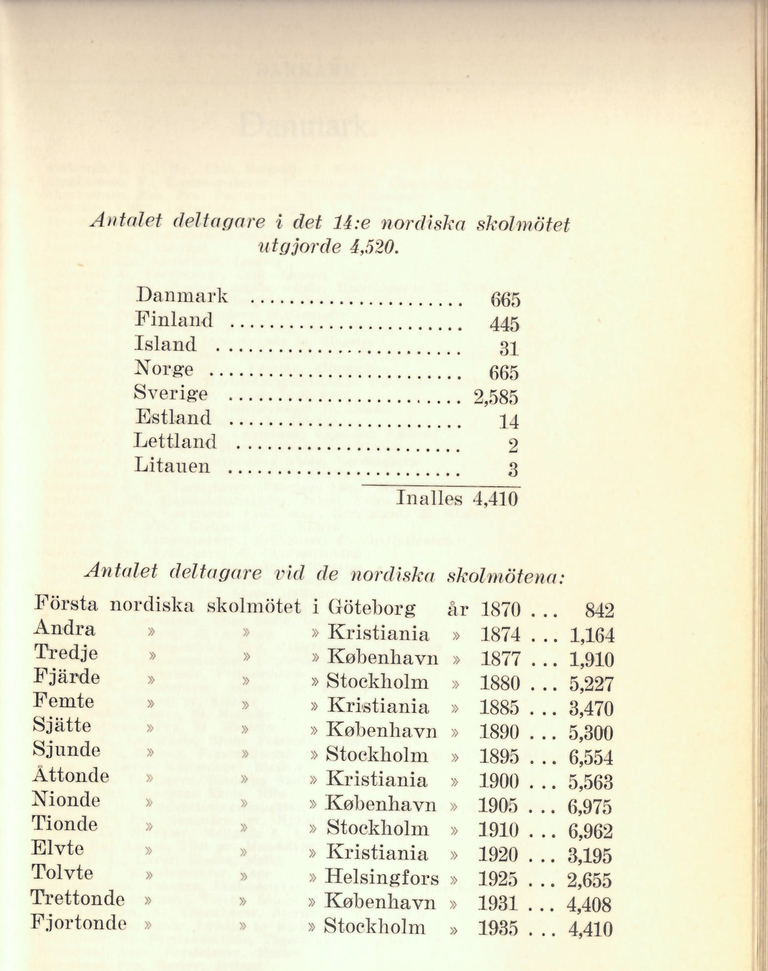
From a report from the meeting of Nordic education professionals in Stockholm 1935

Slide 5
The extent and multiplicity of cooperation – within the field of education
At formal governmental level
Within the Nordic countries
Among the Nordic countries – at international levels; EU, OECD, UNESCO, IEA, …
Under the umbrella of governmental cooperation
NCM, Nordplus- several specialised groups and networks
At administrative levels
Ministries
Local authorities
Separate governmental or administrative agencies – e.g. Directorates of education
Professional bodies
Associations
Teacher unions
Research networks
Nordforsk – networks
School for tomorrow - special fund
NERA – networks
Institutions
Universities, schools; NUAS, NUS
Specialised bodies – teacher groups

Slide 6
Method for collecting data – difficulties
Searching the internet
  Specific nodes – institutions and bibliographic catalogues
  General search
General e-mail inquiry to academic colleagues – I need help here
Interviews (currently five high level veteran experts at the ministry of education)
(All of these will be substantially augmented by interviewing officials at the teacher union level, the municipal level, the school level and by obtaining more concrete information at the documentary and administrative levels.)

Slide 7
The potential solid indicators
Bibliometric references
Publications
  Books, esp. edited books with Nordic contributions, Journals
List of groups ( administrative groups, ad hoc groups, conferences, networks, … )
  Networks (NCM, Nordplus, NERA)
  Conferences, general and dedicated
  Projects
Evidence in documents but primarily in interviews about the direct and indirect influence on policy and practice.

Slide 8
Some international bodies – the time line

Slide 9
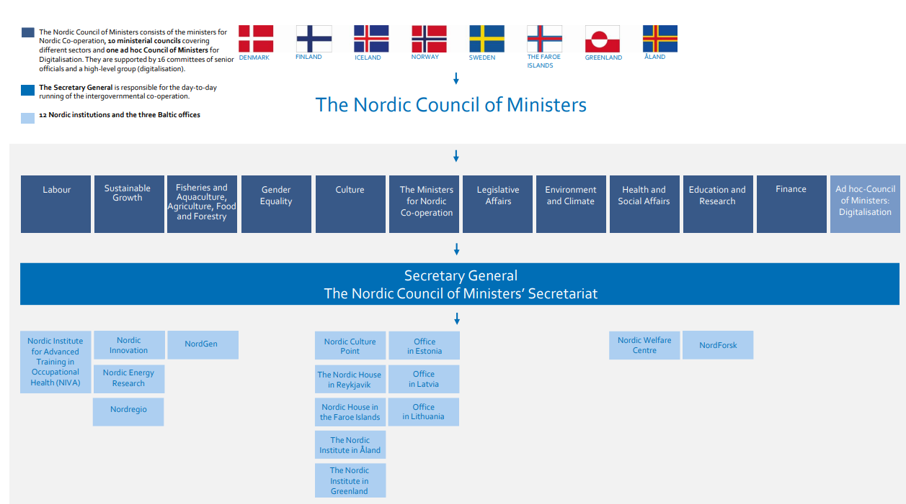
Nordplus established in 1988
NordForsk was established in 2005

Slide 10
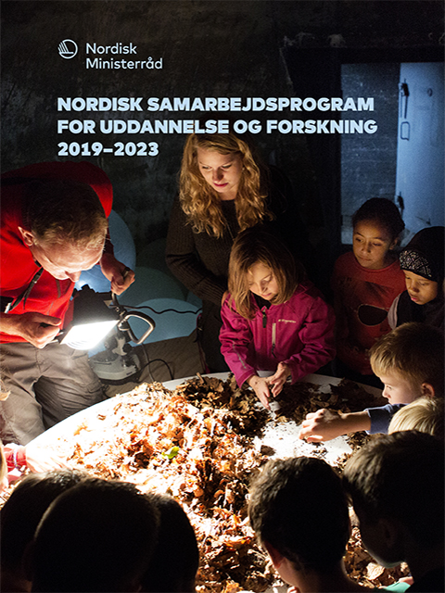
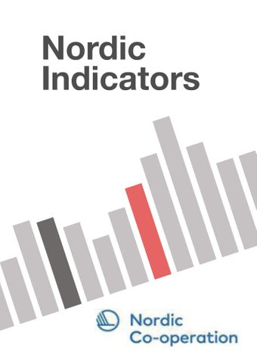
NCM
The Nordic Council of Ministers for Education and
Research focuses on three strategic areas – education,
research and language – and on further developing
existing initiatives and forms of co-operation, as well
as identifying new ones.
Nordic council
Nordic Statistics Nordic Statistics
Freely accessible database featuring statistics that facilitate comparisons between the Nordic countries based on a range of parameters and over time.
Nordic indicator portal (OECD)
iLibrary - Nordic Co-operation
A series of Nordic indicators are freely accessible in the Nordic iLibrary, which is hosted by the OECD.
Nordic Base of Early Childhood Education and Care.
https://www.nb-ecec.org
Om forskningsdatabasen NB-ECEC
NB-ECEC samler kvalitetsvurderet skandinavisk forskning i 0-6-årige børn i dagtilbud. Forkortelsen står for Nordic Base of Early Childhood Education and Care. Databasen retter sig især til studerende inden for pædagogik, fagprofessionelle og undervisere på pædagogiske uddannelser. Databasen opdateres hvert år og rummer nu alle kvalitetsgodkendte studier fra perioden 2006-2017.
Nordisk samarbejde. Databasen er udviklet i et samarbejde mellem Danmarks Evalueringsinstitut (EVA) og svenske Skolverket med tilskud fra i første omgang det norske Kunnskapsdepartementet og senere Utdanningsdirektoratet.

Slide 11
Examples: The extent and multiplicity of professional cooperation
Nordplus operational projects – at – 400-500 projects a year
5310 projects 2008-2019

Slide 14
Some journals within the field of education that are classified as Nordic or Scandinavian – why Nordic?
The idea of the journal is to give researchers and doctoral students a scientific platform for publication in all Nordic languages: Danish, Finnish, Icelandic, Norwegian, Sami, Swedish and also Faroese and Kalaallisut, as well as English language. (Nordisk Barnehagefornskinig)
Vetenskaplig tidskrift med nordiskt fokus på pedagogisk forskning. (NSinED, NFPF).
Vetenskaplig tidskrift som speglar pågående utbildningsvetenskaplig forskning inom Norden. (ScJER)
(NJCIE) is the only journal in the Nordic countries specifically addressing themes within our field and serves as a connecting node for comparative scholars in, or interested in, the region.
Finally, NordSTEP aims to provide a forum which would be characterised by contextual knowledge and awareness of the particularities of Nordic countries as well as continental Europe in relation to international education. The intention is to contribute to a further strengthening of the Nordic voice in a world dominated by Anglo-American research journals.
The journal (NJEH) takes special responsibility for the communication and dissemination of educational history research of particular relevance to the Nordic region (Denmark, Finland, Iceland, Norway, Sweden and political and geographic entities including the Faroe Islands, Greenland, Sápmi and Åland), but welcomes contributions exploring the history of education in all parts of the world.

Slide 15
Interviews – Icelandic case Five veteran and highly placed ministry officials were interviewed (in Icelandic) in December 2019.
They were asked, inter alia, about the nature and extent of Nordic and international cooperation within the field of education, about the use of data and research and about the formalities in policy formation.
Special nature of the Icelandic case
  Scarcity of manpower, not participating at nearly all venues, different traditions of documentation, less detailed expertise but normally a breadth of interaction – a wide perspective, …

Slide 16
The connection with the Nordic colleagues, within the Nordic countries, exist at many levels, at
  the NCM level – both with the normal groups, with ad hoc groups and with special events organized by the chairmanship each year
  the ministerial level, both regular and ad hoc meetings
  these meetings are documented, but rarely detailed minutes are written
  There is rarely a discussion of explicit policies, but still exchanges of information about these. The discussion is much about issues, concerns, initiatives and exchanges of information – thus there is a lot of communication between colleagues
I am inclined to conclude that the communication is better described as interaction, sharing of ideas rather than cooperation
Nordic cooperation at the international level
  The Nordic cooperation is notably also about common policy formation vis-à-vis other venues, such as the OECD, UNESCO, etc. Here we seem to see much more substantive cooperation, where the Nordic representatives coordinate – to a certain extent their views or interventions. This does not mean that they agree on all things, but they determine what they agree on, and when they do, they present a fairly coordinated front. “I must say I had a feeling that sometimes [at UNESCO meetings on education] people were waiting for what the Nordic countries would say.” Again much of this consultation takes place in informal settings.

Slide 17
Can we construct different spheres or arenas of communication among the Nordic countries?
The practical arena
Dedicated conferences
Nordplus networks
The national policy arena
The scientific sphere
The Nordic Council
The Nordic Council of ministers
Nordic Council publications
Nordforsk, grants
Conferences
Agencies, directorates, ministries
Meetings of ministers
Networks, Nera
NUAS
Journals
Books
Co-operation among mandarins
Meetings of professional groups; TU
Administrative arena

Slide 18
The nature of the cooperation in focus – what does it entail? Two questions here
What is the form of cooperation or interaction at each level, or rather at each node, and its relevance?
What is the form of cooperation between the arenas levels – if any?
  In particular how does the scientific arena or level, interact with any of the others? Does it make any serious effort to do so?
  To what extent does the policy arena interact with or take any note of the other arenas?
  The direct, or documented or acknowledged visibility
Do the different nodes operate in their isolated worlds – certainly with connections to similar nodes outside, but not with other nodes?
Is it possible that the relative (Nordic) wealth and expertise within each node isolate them – as happens for all developed disciplines.
  What is the impact – the outcome?
    How do we assess the impact on the voluminous Nordic cooperation we witness?

Slide 19
Conclusions? Emerging questions and observations relating to the interaction observed
Is the interaction primarily (and perhaps increasingly) for sharing ideas and reflection rather than policy guidance – at which ever level or node?
Thus, should we call what we see, interaction (or even augmentation or sharing), rather than cooperation?
What motivates the interaction we see? Why the emphasis on “Nordic” interaction? E.g. in the journals and conferences – or at any level?
Should we make anything of the “locality” or “isolation” of the various interactions we see?
In policy terms, are the “other” Nordic systems more a reference point or an anchor, rather than a critical partner within each system?
Perhaps we sometimes neglect the importance of the Nordic “family” in international (European, OECD, global) settings.
Can we use this material to understand better the gaping fissures, more generally observed, between research on the one hand and both practice and policy on the other?
Is what we see, in terms of interaction or cooperation at the Nordic level, perhaps an equally important part of the Nordic model, as the system aspect?

Slide 20
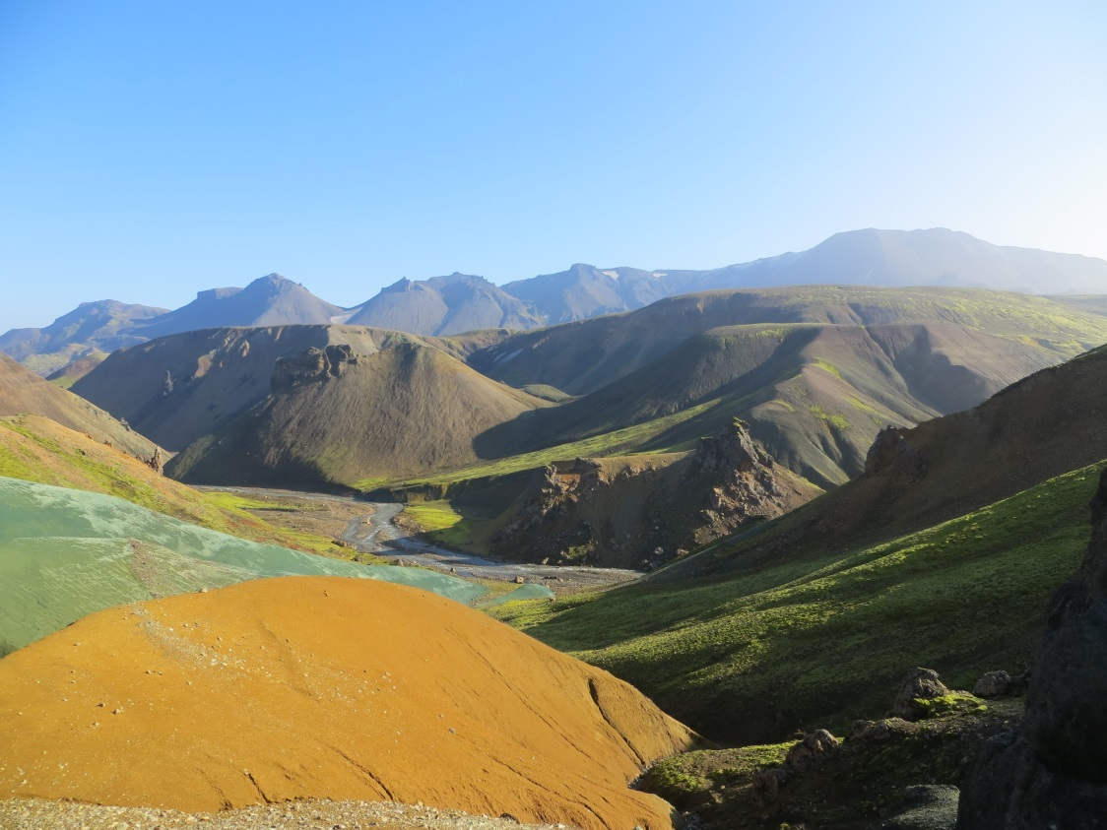
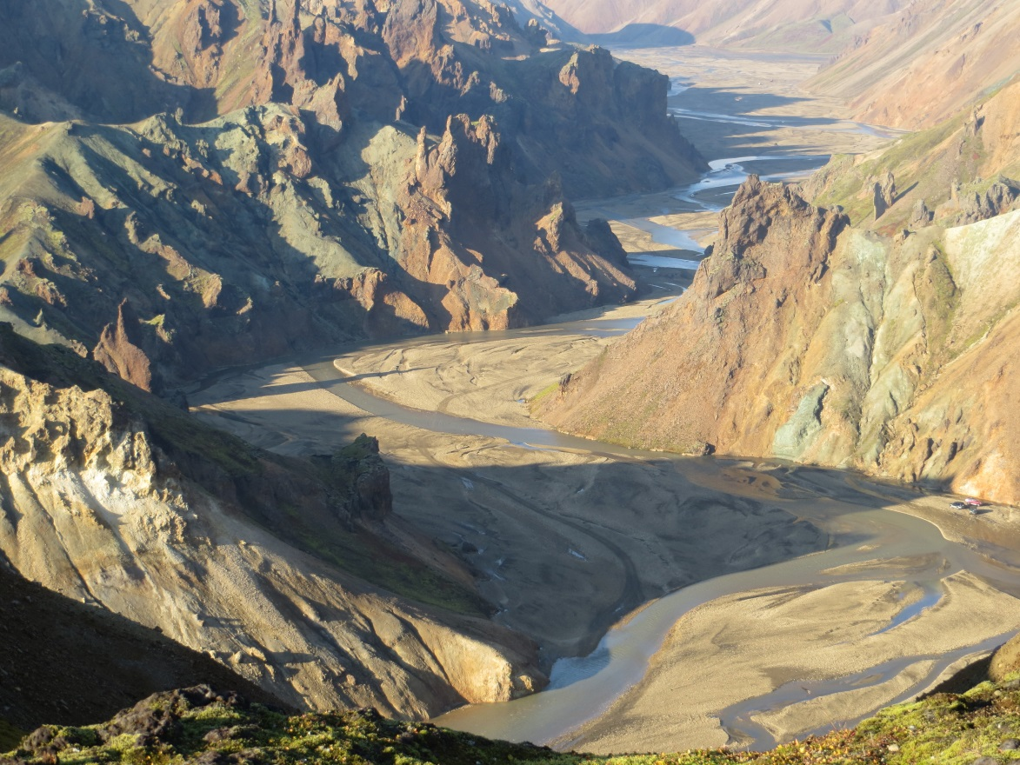
Thanks

